Slide 1
Donor Retention Project
Ian Kimura

Slide 2
Why Donor Retention?
The Problem
Many occasions where donors often give once or a few times and then stop
This is important because retaining donors is more cost effective than acquiring new ones
According to NonProfitEasy, “It costs about five times more to acquire one new donor than it does to retain a donor

Slide 3
What we set out to learn?
Why do some donors stop giving while others continue
Can we predict which donors are at risk of stopping donations?
How can we use this information to take action?

Slide 4
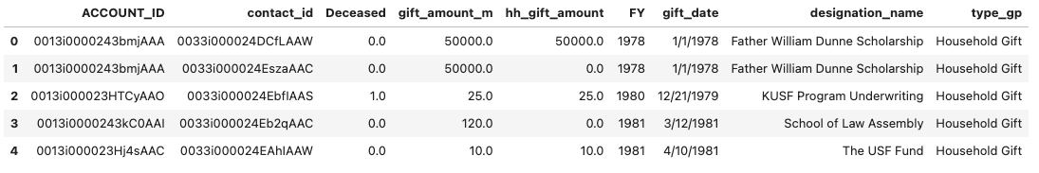
Introducing the Data

Slide 5
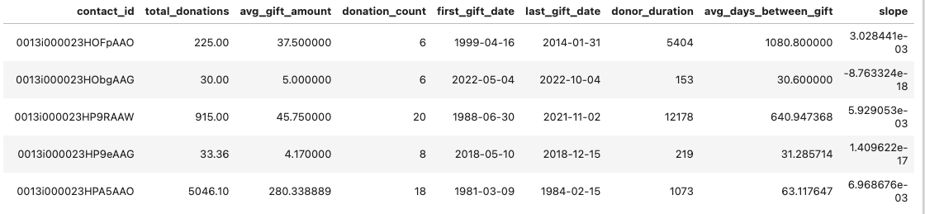
Data cleaning

Slide 6
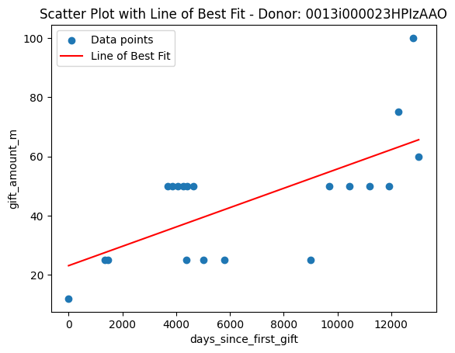
How we predict at-risk donors?
We use past donation patterns of those who had stopped donation to identify warning signs
Key risk indicators include:
Decreasing donation amounts
Increased time between donations
Fewer overall donations over time

Slide 7
Model Results
Test accuracy: 93.19%
Model correctly predicted donor retention 93.19% of the time on unseen data
High accuracy ensures that the model is effective in predicting both donors who continue donating and those who stop
Recall for Churned Donors: 94.06%
Model correctly identified 94.06% of donors who stopped donating
High recall is important because it helps us find most of the donors who have stopped giving

Slide 8
What this means for the organization?
We can now take action before donors leave
Prediction helps us focus our retention efforts where they matter most
Even a small improvement in retention can significantly impact fundraising revenue

Slide 9
Actionable Recommendations
Engagement strategy
Personal outreach for at-risk donors
Targeted messaging
Sending tailored communications to high risk donors
Loyalty programs
incentivizing repeat donations

Slide 10
Thank you!

